Slide 1

EOS - LECTURE 1
Embedded Operating System
The basics of
Samuele Germiniani
samuele.germiniani@univr.it
Graziano Pravadelli
graziano.pravadelli@univr.it

Slide 2
EOS - LECTURE 1
OUTLINE
FreeRTOS introduction 10m
The FreeRTOS Distribution
  2.1 Organization of files 5m
  2.2 Creating a FreeRTOS Project 1m + 3m
  2.3 Data Types and Coding Style Guide 2m
Heap Memory Management 2m + 2m
Task Management
  4.1 The basics of a task 2m
  4.2 Creating Tasks 5m + 10m
  4.3 Time Measurement and the Tick Interrupt 4m + 5m
  4.4 Blocked and Suspended 5m + 10m
  4.5 The Idle Task and the Idle Task Hook 2m + 5m
  4.6 Changing the Priority of a Task 2m + 5m
  4.7 Deleting a Task 1m + 3m
5. Semaphores 2m + 5m
6. Queue
6.1 Characteristics of a queue 2m
6.2 Using a queue 3m + 10m
7. Task notification 1m + 5m
Part1 break Part2
60m + 10m + 60m

Slide 3
EOS - LECTURE 1
Verifica di Firmware
1 - FreeRTOS introduction

Slide 4
EOS - LECTURE 1
1 - FreeRTOS introduction
What is FreeRTOS?
FreeRTOS is a real-time kernel on top of which embedded applications
can be built to meet their hard real-time requirements.
An application is organized as a collection of independent threads (task).
The kernel decides which thread should be executing by examining the priorities
The designer assigns the priorities to implement hard/soft real-time constraints

Slide 5
EOS - LECTURE 1
1 - FreeRTOS introduction
Why FreeRTOS?
For its value proposition!
Supported
Strictly quality controlled and professionally developed
It is truly free to use in commercial applications without any
requirement to expose your proprietary source code.

Slide 6
EOS - LECTURE 1
1 - FreeRTOS introduction
Why a real-time kernel?
Abstracting away timing information
Maintainability/Extensibility
Modularity
Team development
Easier testing
Code reuse
Improved efficiency
Idle time
Power Management

Slide 7
EOS - LECTURE 1
1 - FreeRTOS introduction
FreeRTOS features
FreeRTOS has the following standard features
Pre-emptive or co-operative operation
Very flexible task priority assignment
Flexible, fast and light weight task notification mechanism
Queues
Binary semaphores
Counting semaphores
Mutexes
Recursive Mutexes
Software timers

Slide 8
EOS - LECTURE 1
1 - FreeRTOS introduction
FreeRTOS licensing
The FreeRTOS open source license is designed to ensure:
1. FreeRTOS can be used in commercial applications.
2. FreeRTOS itself remains freely available to everybody.
3. FreeRTOS users retain ownership of their intellectual property.

Slide 9
EOS - LECTURE 1
Verifica di Firmware
2 - The FreeRTOS Distribution

Slide 10
EOS - LECTURE 1
2.1 Organization of files
FreeRTOS supports over 20 compilers and 30 processors
Definition: FreeRTOS port
A supported combination of compiler and processor
FreeRTOS C files
Common to all ports
Port specific
FreeRTOSConfig.h

Slide 11

EOS - LECTURE 1
2.1 Organization of files
Go to https://www.freertos.org/ and download the FreeRTOS 202104.00
sources
wget https://github.com/FreeRTOS/FreeRTOS/releases/download/202104.00/FreeRTOSv202104.00.zip
unzip FreeRTOSv202104.00.zip && rm FreeRTOSv202104.00.zip
cd FreeRTOSv202104.00/ && ls

Slide 12
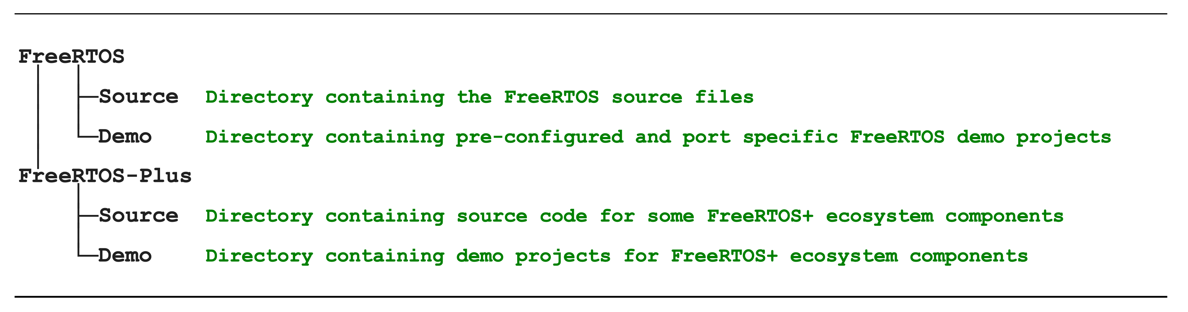
EOS - LECTURE 1
2.1 Organization of files
The Top Directories in the FreeRTOS Distribution

Slide 13
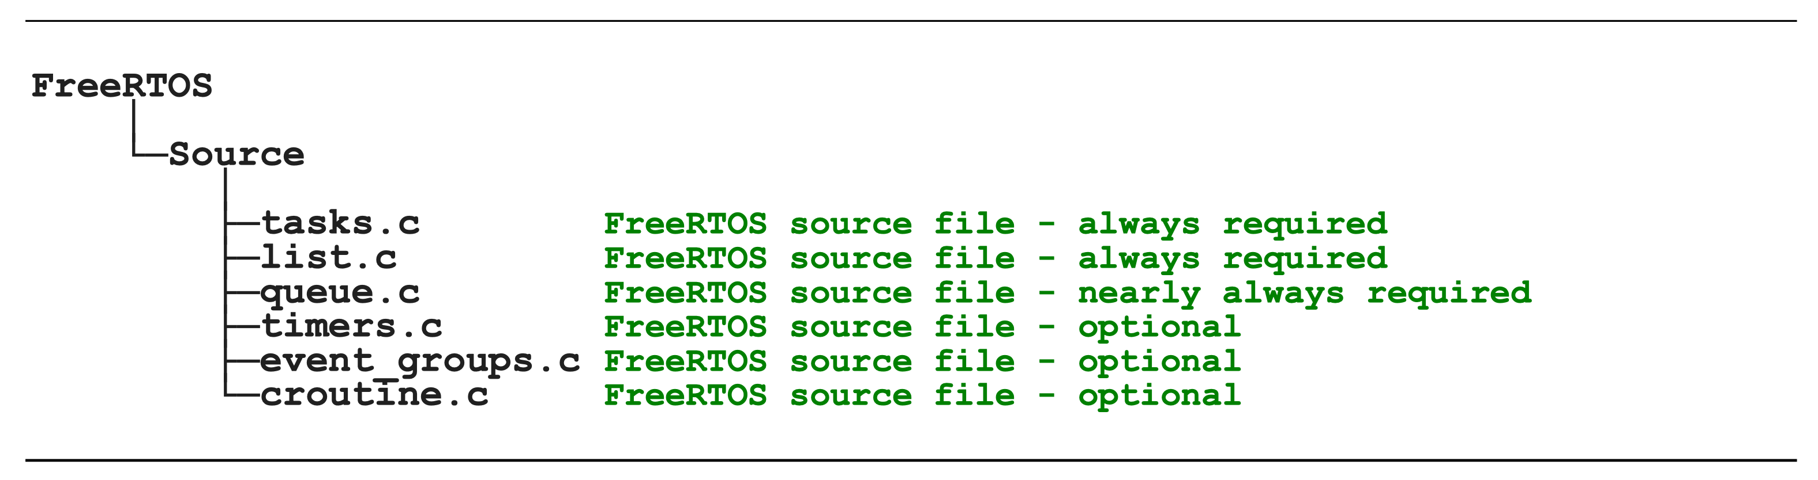
EOS - LECTURE 1
2.1 Organization of files
FreeRTOS Source Files Common to All Ports

Slide 14
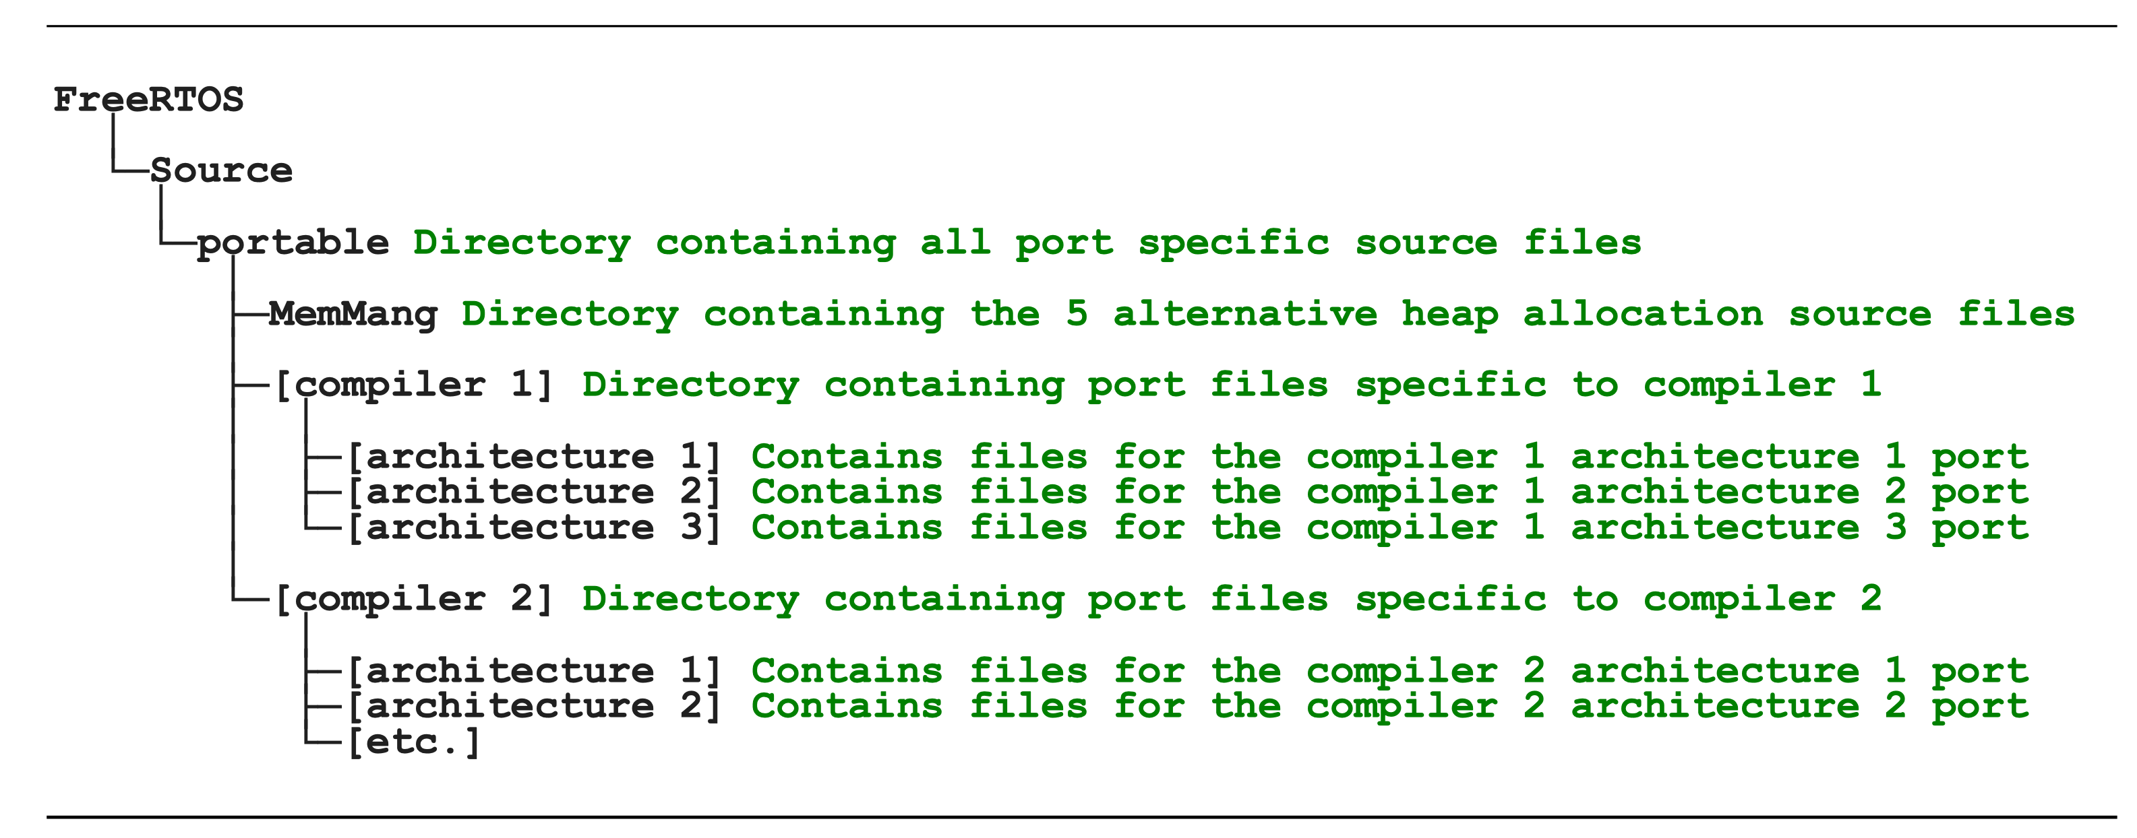
EOS - LECTURE 1
2.1 Organization of files
FreeRTOS Source Files Specific to a Port

Slide 15
EOS - LECTURE 1
2.1 Organization of files
Include paths
FreeRTOS/Source/include
FreeRTOS/Source/portable/[compiler]/[architecture]
A path to the FreeRTOSConfig.h header file
It contains the application's configuration

Slide 16
EOS - LECTURE 1
  2.2 Creating a FreeRTOS Project
How to start a new project
FreeRTOS provides a demo for each compiler/architecture combination
1. Find your compiler + target architecture (we are using the POSIX simulator)
cd FreeRTOS/Demo/Posix_GCC/
2. Check if it compiles correctly
make
3. Start the demo
./build/posix_demo
4. Remove all the demo files Download a ready empty project
cd .. && rm -rf Posix_GCC
git clone https://gitlab.com/SamueleGerminiani/posix_eos1 && cd posix_eos1

Slide 17
EOS - LECTURE 1
  2.3 Data Types and Coding Style
Variable Names
Variables are prefixed with their type: c for char, s for int16_t (short),… x for non-standard types
Function Names
Functions are prefixed with both the type they return, and the file they are defined within:
vTaskPrioritySet() returns a void and is defined within task.c
(File scope (private) functions are prefixed with prv.)

Slide 18
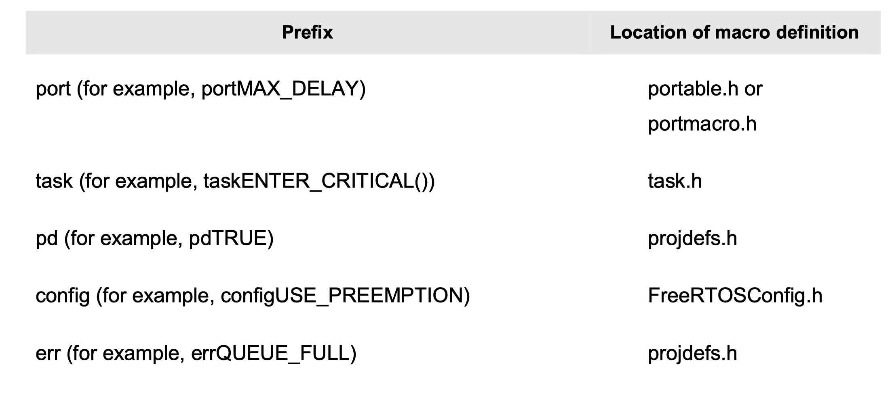
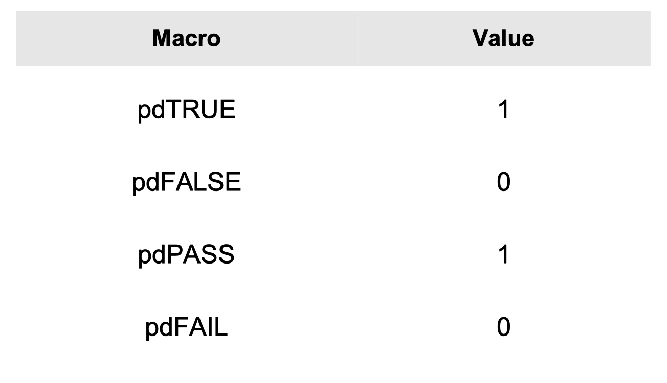
EOS - LECTURE 1
  2.3 Data Types and Coding Style
Macro Names
Upper case, and prefixed with lower case letters that indicate where the macro is defined

Slide 19
EOS - LECTURE 1
Verifica di Firmware
3. Heap Memory Management

Slide 20
EOS - LECTURE 1
  3. Heap Memory Management
Dynamic memory allocation
FreeRTOS comes with five example implementations of both pvPortMalloc() and vPortFree()
The five examples are defined in the heap_1.c, heap_2.c, heap_3.c, heap_4.c and heap_5.c source files respectively, all of which are located in the FreeRTOS/Source/portable/MemMang directory.
Compile your project with the preferred implementation

Slide 21
EOS - LECTURE 1
  3. Heap Memory Management
Dynamic memory allocation
What memory implementation are we using?

Slide 22
EOS - LECTURE 1
Verifica di Firmware
4 - Task management

Slide 23
EOS - LECTURE 1
  4.1 The basics of a task
What is a task function?
Tasks are implemented as C functions.
The only thing special about them is their prototype.
N.B FreeRTOS tasks must not be allowed to return from their
implementing function in any way

Slide 24
EOS - LECTURE 1
  4.1 The basics of a task
Create a task function
void vTask1(void *pvParameters) {
const char *pcTaskName = "Task 1 is running\r\n";
volatile uint32_t ul; /* volatile to ensure ul is not optimized away. */
/* As per most tasks, this task is implemented in an infinite loop. */
for (;;) {
/* Print out the name of this task. */
console_print("%s\n",pcTaskName);
/* Delay for a period. */
for (ul = 0; ul < 100000000; ul++) {
/* This loop is just a very crude delay implementation.
There is nothing to do in here. Later examples will replace this crude
loop with a proper delay/sleep function. */
}
}
}
--> Put this function in main.c

Slide 25
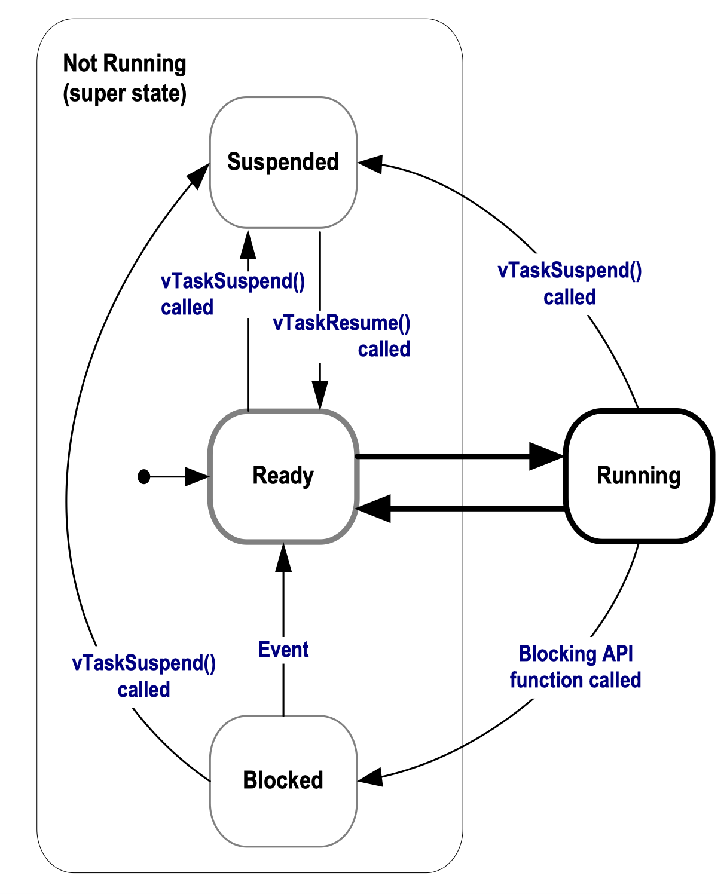
EOS - LECTURE 1
  4.1 The basics of a task
Task States
Ready : The task is waiting to enter the running state
Running: The task is using the CPU (we assume a uniprocessor system)
The scheduler selects always the Task with the highest priority in the ready state

Slide 26
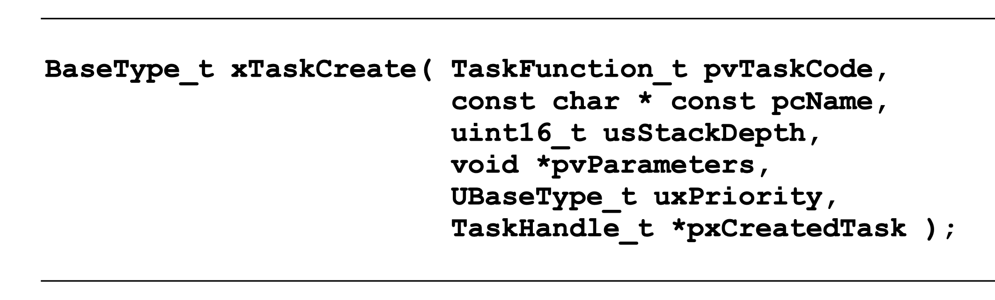
EOS - LECTURE 1
4.2 Creating Tasks
A pointer to the function that implements the task
The xTaskCreate() API Function
A descriptive name for the task. This is not used by FreeRTOS in any way.
Tells the kernel how large to make the stack for this task.
Defines the priority at which the task will execute. Priorities can be assigned from 0, which is the lowest priority, to (configMAX_PRIORITIES – 1),
Task functions accept a parameter of type pointer to void ( void* ). The value assigned to pvParameters is the value passed into the task.
Used to reference the task from other entities

Slide 27
EOS - LECTURE 1
4.2 Creating Tasks
The xTaskCreate() API Function
Use the API function to create tasks
In file main.c, define task function vTask2 (identical to vTask1 except that it prints a different message)
In file main.c, function "main" (before starting the scheduler), use the API function to create two runnable tasks (one for function vTask1 and one for vTask2). Give the same priority to both tasks
Example:
xTaskCreate( taskFunction, "Inconsequential string", 1000, NULL, 1, NULL );
N.B. put NULL when you don't use a parameter

Slide 28
EOS - LECTURE 1
4.2 Creating Tasks
The xTaskCreate() API Function
Activate pre-emption
3. In file FreeRTOSConfig.h, set configUSE_PREEMPTION to activate pre-emption

Slide 29
EOS - LECTURE 1
4.2 Creating Tasks
The xTaskCreate() API Function
Using the task parameter
Use the task parameter to pass the string that should be printed
Remove vTask2
Make vTask1 generic (vTask1 --> vTask)
3. In function main, add the string as a parameter of xTaskCreate() (remember to cast to void*)
4. Modify vTask to retrieve the string from pvParameters (remember to cast to char*).

Slide 30
EOS - LECTURE 1
4.3 Time Measurement and the Tick Interrupt
Tick interrupt
A timed interrupted whos execution frequency is determined by configTICK_RATE_HZ
In FreeRTOS, time is measured after the tick interrupt
The time between two tick interrupts is called the "tick period".
One time slice equals one tick period.
Example:
if configTICK_RATE_HZ is set to 100 (Hz), then the time slice will be 10 milliseconds

Slide 31
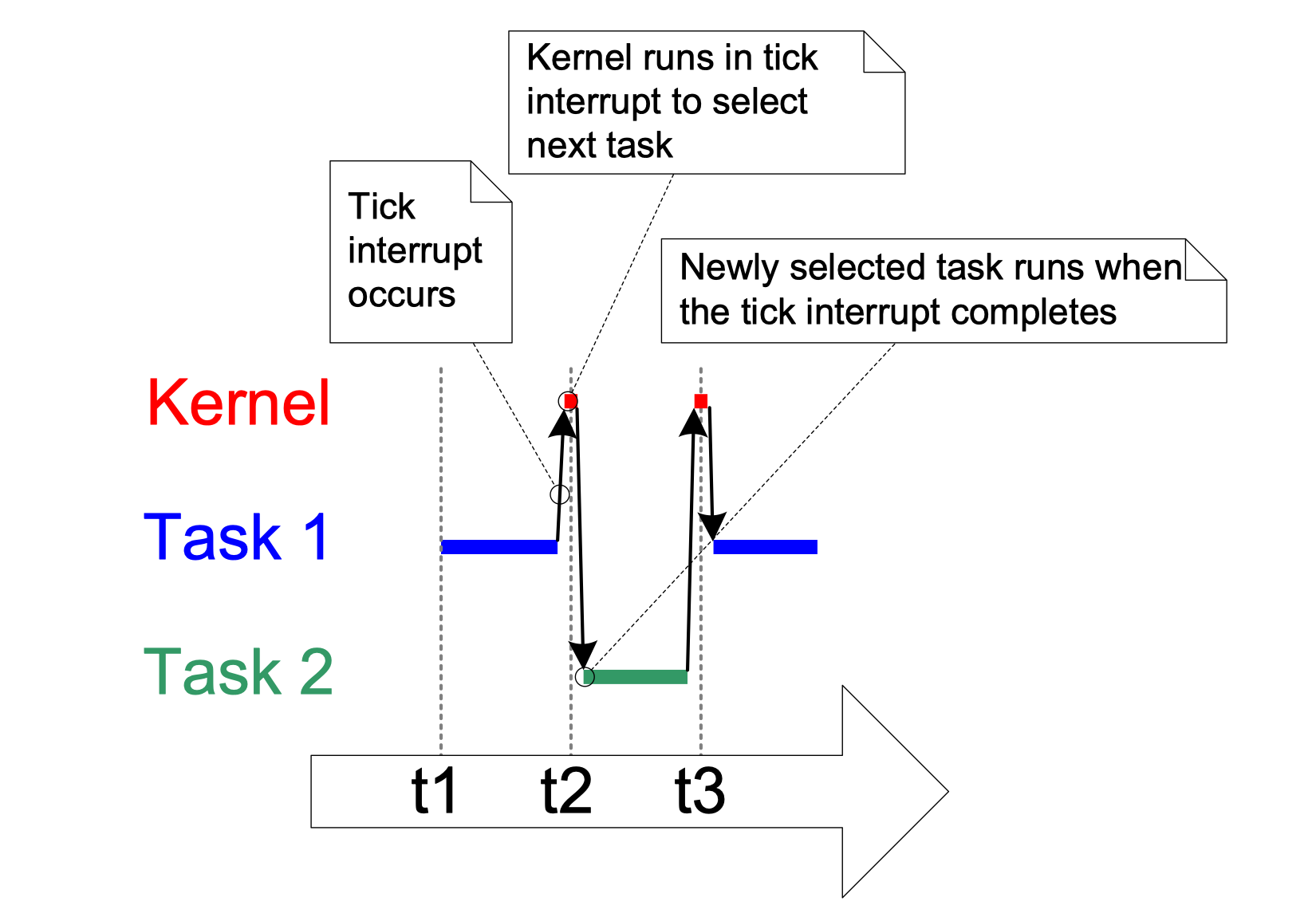
EOS - LECTURE 1
4.3 Time Measurement and the Tick Interrupt
Tick interrupt
The tick interrupt implements
time slicing

Slide 32
EOS - LECTURE 1
4.3 Time Measurement and the Tick Interrupt
Tick interrupt
1. Find configTICK_RATE_HZ and increase it to 1000.

Slide 33
EOS - LECTURE 1
4.3 Time Measurement and the Tick Interrupt
Experimenting with priorities
Change the priority of "Task 1" to 10
Answer the following question
What happens to Task 2? Why?

Slide 34
EOS - LECTURE 1
  4.4 Blocked and Suspended
The Suspended State
Task suspended using the
vTaskSuspend() API function
The Blocked State
A task waiting for an event:
Temporal events
Synchronization events:
queues, semaphores

Slide 35
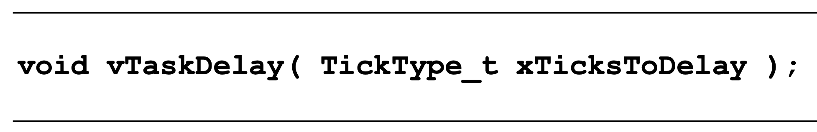
EOS - LECTURE 1
  4.4 Blocked and Suspended
Using the Blocked state to create a delay
1. Modify vTask to make it wait for 100ms using vTaskDelay() instead of the current wasteful "for" cycle
The macro pdMS_TO_TICKS() can be used to convert a time specified in milliseconds into a time specified in ticks

Slide 36
EOS - LECTURE 1
  4.4 Blocked and Suspended
vTaskDelay() vs vTaskDelayUntil()
Time in which Task leaves the blocked state is relative to the time at which vTaskDelay() was called.
vTaskDelayUntil() specifies the exact tick count value at which the calling task should be woken.

Slide 37
EOS - LECTURE 1
  4.4 Blocked and Suspended
How to use vTaskDelayUntil()
// Perform an action every 10 ticks.
void vTaskFunction(void *pvParameters) {
TickType_t xLastWakeTime;
const TickType_t xFrequency = 10;
// Initialise the xLastWakeTime variable with the current time.
xLastWakeTime = xTaskGetTickCount();
for (;;) {
// Wait for the next cycle.
vTaskDelayUntil(&xLastWakeTime, xFrequency);
// Perform action here.
}
}
The function xTaskGetTickCount() can be used to get the current "time" in tick counts.
Gets automatically updated after every delay
(that is why we have to give a pointer)

Slide 38
EOS - LECTURE 1
  4.4 Blocked and Suspended
Using the Blocked state to create a delay
(vTaskDelayUntil)
1. Modify vTask to make it wait using vTaskDelayUntil() instead of vTaskDelay()

Slide 39
EOS - LECTURE 1
  4.4 Blocked and Suspended
Suspending/resuming processes
Create a task "vBlocker" that keeps suspending or resuming Task 2 every 500 ms
N.B. you will need to store the handler (use global variables)
of Task 2, see xTaskCreate API.

Slide 40
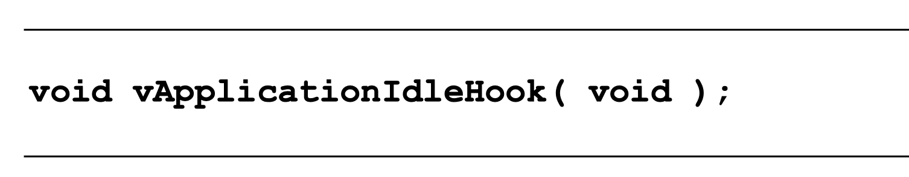
EOS - LECTURE 1
  4.5 The Idle Task and the Idle Task Hook
The idle Task
There must always be at least one task that can enter the Running state
The idle Task executes when no other tasks can
It runs at the lowest priority (0)
The idle Task Hook
The idle task can be configured through a Hook function
Used to execute low priority, background, or continuous processing functionalities.
n.b. An Idle task hook function must never attempt to block or suspend.

Slide 41
EOS - LECTURE 1
  4.5 The Idle Task and the Idle Task Hook
Using the idle task
In file, FreeRTOSHooks.c , implement the idle task hook to increment a counter each time it is executed
Task1 must print the counter every second

Slide 42
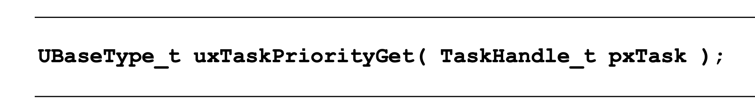
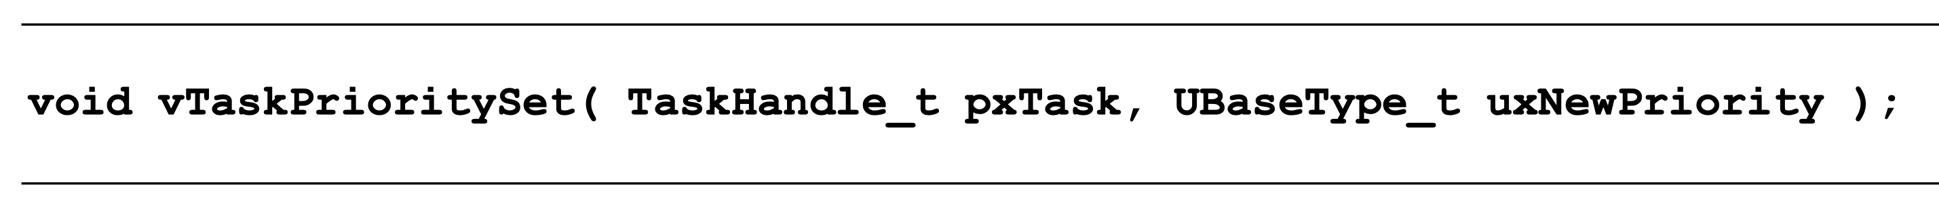
EOS - LECTURE 1
  4.6 Changing the Priority of a Task
The vTaskPrioritySet()/uxTaskPriorityGet() API Function
The vTaskPrioritySet() API function can be used to change the priority of any task after the scheduler has been started.
priority must be < configMAX_PRIORITIES, where configMAX_PRIORITIES is a compile time constant set in the FreeRTOSConfig.h header file.

Slide 43
EOS - LECTURE 1
  4.6 Changing the Priority of a Task
Changing priorities
Create an arbiter task that swaps the priority of Task1 and Task2
every 2 seconds.
Task1 and Task2 must print their name and their priority every 200 ms.
(make sure that Task1 and Task2 are created with different priorities)
n.b passing NULL to an API requiring
a TaskHandle_t will cause the API to
use the caller's task handle instead

Slide 44
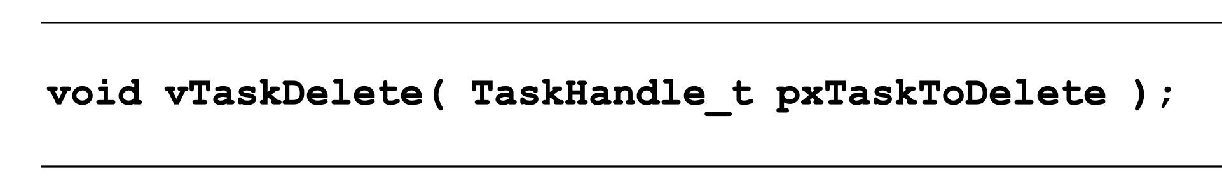
EOS - LECTURE 1
  4.7 Deleting a Task
The vTaskDelete() API Function
Create an "eraser" task that deletes Task1, Task2 and arbiter after 5 second.
After that, eraser suspends himself.

Slide 45
EOS - LECTURE 1
Verifica di Firmware
5 - Semaphores

Slide 46
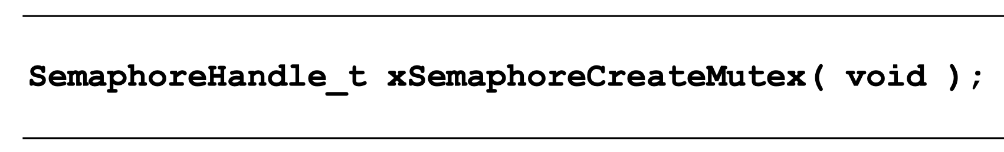
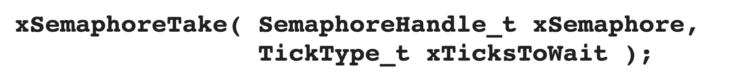
EOS - LECTURE 1
  5 - Semaphores
Mutex
A Mutex is a special type of binary semaphore that is used to control access to a resource that is shared between two or more tasks.
How to use a mutex
Create a Mutex
Take a mutex when accessing shared resources
Time to wait for the mutex to be freed.
Set it to "portMAX_DELAY", to wait indefinitely
Free the mutex

Slide 47
EOS - LECTURE 1
  5 - Semaphores
Modifying the console_print function
The "standard out" is a shared resource.
Use a mutex to make it mutually exclusive.
In file console.c, declare a mutex variable.
In file console.c, function console_init, initialise the mutex (create)
In file console.c, function console_print, take the mutex before
accessing the standard out (take)
4. In file console.c, function console_print, free the mutex after
accessing the standard out (give)

Slide 48
EOS - LECTURE 1
Verifica di Firmware
6 - Queue

Slide 49
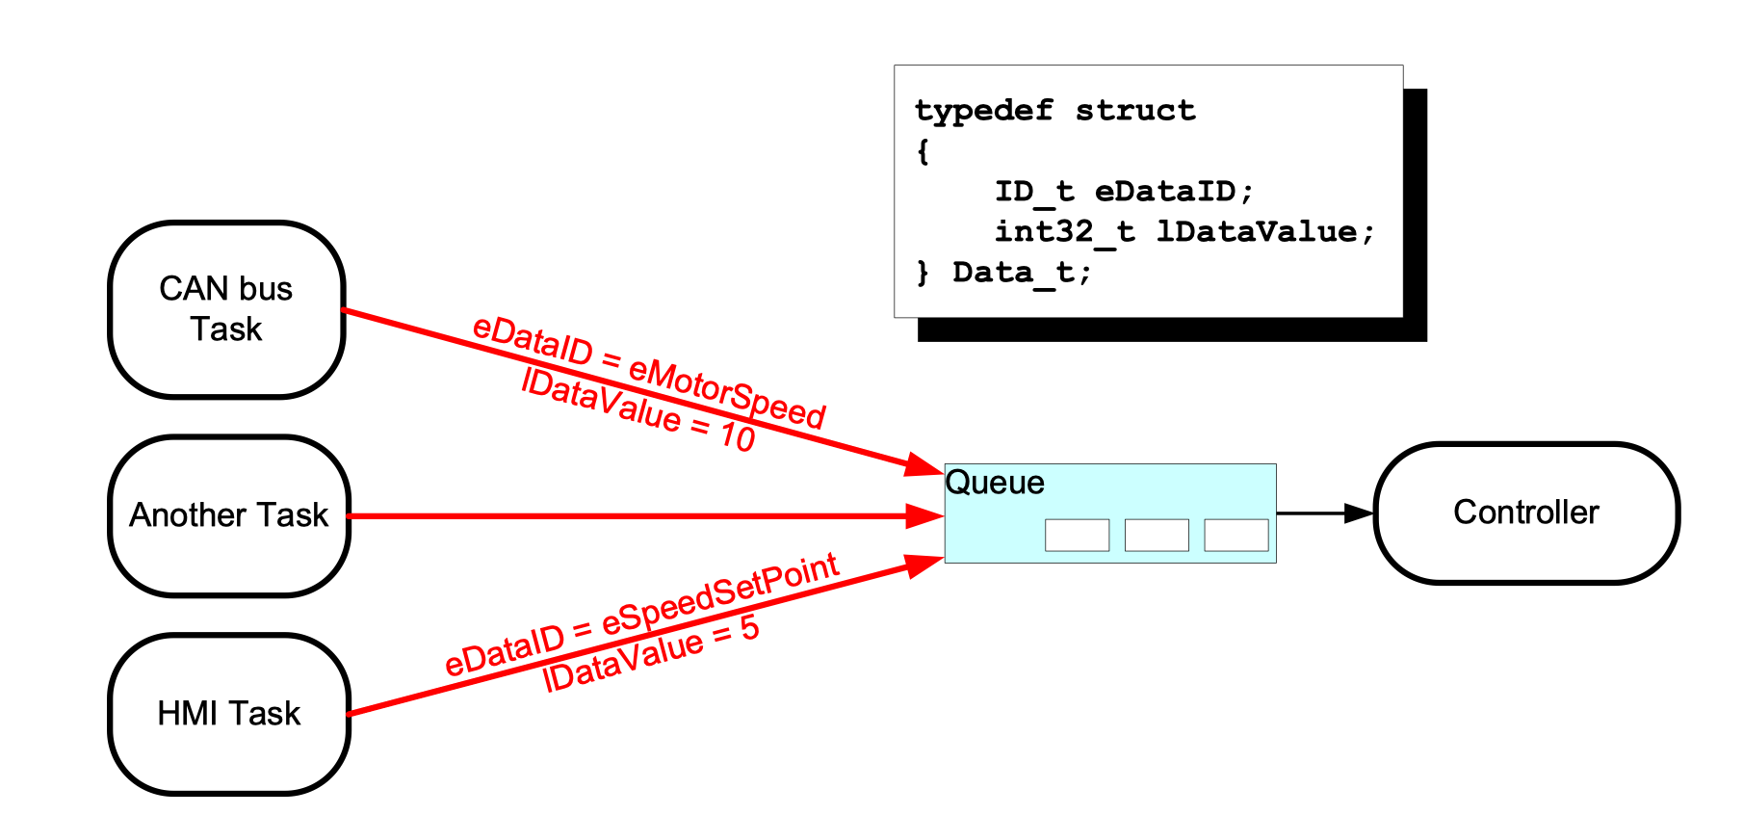
EOS - LECTURE 1
  6 - Queue
queues are a type of container designed to operate in a FIFO context, where elements are inserted into one end of the container and extracted from the other
What is a queue?

Slide 50
EOS - LECTURE 1
  6 - Queue
How to use a generic queue in FreeRTOS
Create a Queue
The returned value should be stored as the handle to the created queue
The maximum number of items that the queue being created can hold at any one time
The size in bytes of each data item that can be stored in the queue.

Slide 51
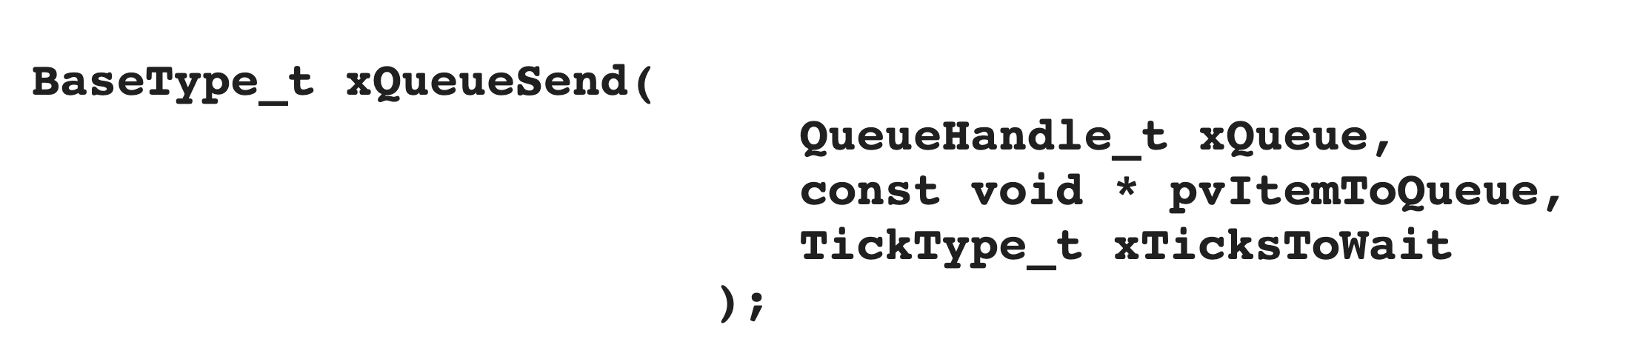
EOS - LECTURE 1
  6 - Queue
How to use a generic queue in FreeRTOS
Add element
The maximum amount of time the task should block waiting for space to become available on the queue.
Set it to "portMAX_DELAY", to wait indefinitely
The handle to the queue on which the item is to be posted
A pointer to the item that is to be placed on the queue

Slide 52
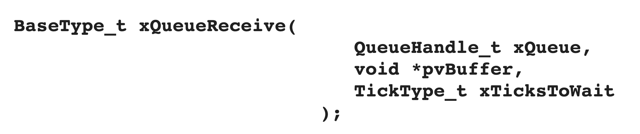
EOS - LECTURE 1
  6 - Queue
How to use a generic queue in FreeRTOS
Remove element
The maximum amount of time the task should block waiting for an item to receive.
Set it to "portMAX_DELAY", to wait indefinitely
The handle to the queue on which the item is to be posted
Pointer to the buffer into which the received item will be copied

Slide 53
EOS - LECTURE 1
  6 - Queue
Using queues
1. In file main.c, declare a queue handle variable.
2. In file main.c, function main, initialize the queue (max 5 elements)
3. Write a "sender" task that adds a random integer every 100ms on a queue
4. Write a "receiver" task that removes the integer from the same queue every 100ms.

Slide 54
EOS - LECTURE 1
Verifica di Firmware
7 - Task notification

Slide 55
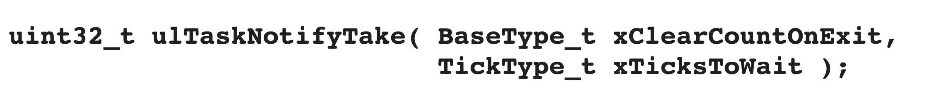
EOS - LECTURE 1
6 - Task notification
Task notifications are used to simplify communication between tasks
A direct task notification is an event sent directly to a task that can unblock the receiving task
Send a task notification
  Always use (pdTRUE, portMAX_DELAY)
Wait for a notification

Slide 56
EOS - LECTURE 1
  6 - Task notification
Using task notifications
Create 2 tasks. Each task prints a string every 100 ms.
Each task must wait for a notification before printing the string.
Each task must send a notification after printing the string.
The first task prints the first string without waiting for a notification.

